Slide 1
DOCKER

Slide 2
AGENDA
Learning the Basics of Docker
The Dockerfile, Builds and Network Configuration
Docker Commands and Structures
Integration and Use Cases
Docker compose
Setting up private registry
Docker security

Slide 3
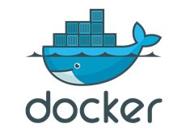
Learning the Basics of Docker

Slide 4
History
Chroot (version 7 Unix, 1979)
  Provide an isolated disk space for each process.
Solaris zones (Solaris 10, 2004)
  Solaris Containers were introduced for x86 and SPARC systems.
LXC (Linux, 2008)
  It was implemented using cgroups and Linux namespaces.
Docker (Linux,2013)
  Container Management System.
  It was developed as an internal project at a platform-as-a-service company called dotCloud and later renamed to Docker.

Slide 5
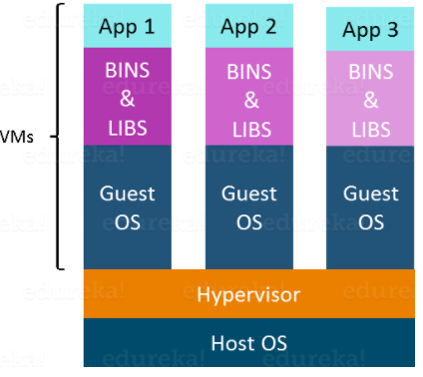
What is Virtualization?
Virtualization is the technique of importing a Guest operating system on top of a host operating system (hypervisor).
This technique was a revelation at the beginning because it allowed developers to run multiple operating systems in different virtual machines all running on the same host.
This eliminated the need for extra hardware resource.

Slide 6
Advantages of Virtualization
Multiple operating systems can run on the same machine
Maintenance and Recovery were easy in case of failure conditions as image management gets easier
Total cost of ownership was also less due to the reduced need for infrastructure

Slide 7
Disadvantages of Virtualization
Running multiple Virtual Machines can lead to oversubscription
Hypervisors are not as efficient as the host operating system
Because of the guest OS running on top of the hypervisor, which will have its own kernel and set of libraries and dependencies.
Boot up process is long and takes time

Slide 8
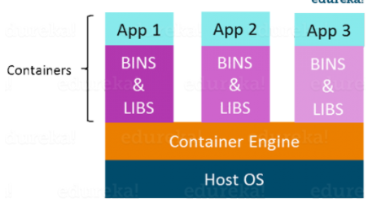
Containers
Containers are a method of operating system virtualization that allow you to run an application and its dependencies in resource-isolated processes.
Containers can run on VMs
Containerization is more efficient
  No guest OS here and utilizes a host’s operating system,
  Share relevant libraries & resources as and when needed unlike virtual machines.

Slide 9
Containerization (Continued)
Application specific binaries and libraries of containers run on the host kernel, which makes processing and execution very fast.
  Containers share, host operating system and holds only the application related binaries & libraries due to which booting-up a container takes only a fraction of a second.
They are lightweight and faster than Virtual Machines.
Notes:
https://aws.amazon.com/what-are-containers/

Slide 10
Advantages of Containerization
Environment Consistency
Operational Efficiency
Developer Productivity
Version Control

Slide 11
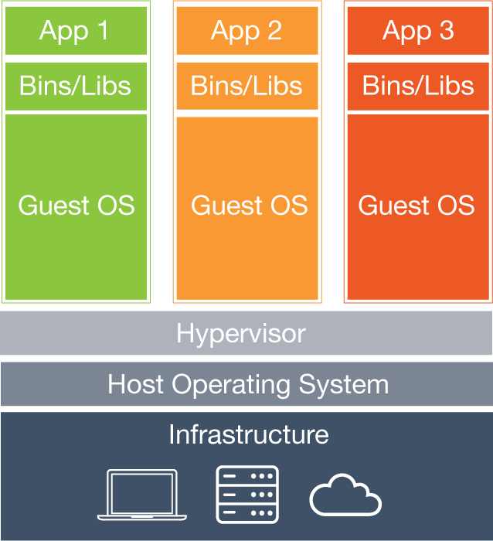
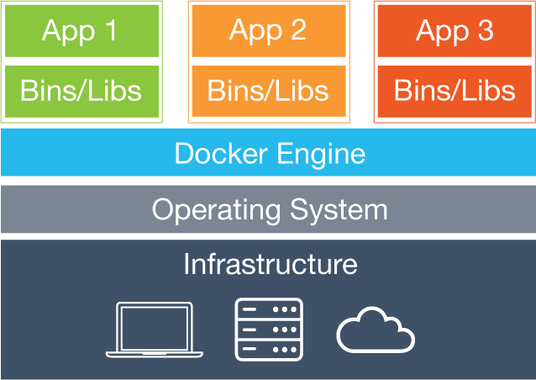
Virtual Machines vs Containers
Containers
VMs
Virtual Machines
Each virtual machine (VM) includes the app, the necessary binaries and libraries and an entire guest operating system
Containers
Containers include the app & all of its dependencies, but share the kernel with other containers.
Run as an isolated process in userspace on the host OS
Not tied to any specific infrastructure – containers run on any computer, infrastructure and cloud.
Notes:
Now, let's look at how a virtual machine (VM) is different from a container.
While containers may sound like a VM, the two are distinct technologies. With VMs each virtual machine includes the application, the necessary binaries and libraries and the entire guest operating system.
Whereas, Containers include the application, all of its dependencies, but share the kernel with other containers and are not tied to any specific infrastructure, other than having the Docker engine installed on its host – allowing containers to run on almost any computer, infrastructure and cloud.
Note - at this time, Windows and Linux containers require that they run on their respective kernel base, therefore, Windows containers cannot run on Linux hosts and vice versa.

Slide 12
Overview of Docker
Docker is an open platform for developing, shipping, and running applications.
Docker enables you to separate your applications from your infrastructure so you can deliver software quickly.
By taking advantage of Docker’s methodologies for shipping, testing, and deploying code quickly, you can significantly reduce the delay between writing code and running it in production.
Supported by several cloud platforms including Amazon EC2, Google Compute Engine, and RackSpace.
Notes:
Key Points:
Docker is a popular open source project based on Linux containers.
Docker is written in go and developed by Dotcloud (A PaaS Company).
Docker is basically a container engine which uses the Linux Kernel features like namespaces and control groups to create containers on top of an operating system and automates application deployment on the container.
It provides and lightweight environment to run your application code.
Docker has an efficient workflow for moving your application from developers laptop, test environment to production.
Docker is incredibly fast and it can run on the host with compatible Linux Kernel.

Slide 13
Docker Features
Light-Weight
Portable
Self-sufficient
Easy and Faster Configuration
Increase productivity
Application Isolation
Swarm
Routing Mesh
Services
Security Management

Slide 14
Docker - Use Cases
Development environment
Environments for integration tests
Quick evaluation of software
Microservices
Multi-Tenancy
Unified execution environment (dev → test → prod (local, VM, cloud, ...)

Slide 15
Docker vs Docker Container
Docker is a containerization platform that packages your application and all its dependencies together in the form of a docker container to ensure that your application works seamlessly in any environment.
Docker Container is a standardized unit which can be created on the fly to deploy a particular application or environment.
It could be an Ubuntu container, CentOS container, etc. to full-fill the requirement from an operating system point of view.
Also, it could be an application oriented container like PHP container or a Tomcat-Ubuntu container etc.

Slide 16
Namespace
Docker makes use of kernel namespaces to provide the isolated workspace called the container.
Docker creates a set of namespaces for that container.
    PID namespace for process isolation.
    NET namespace for managing network interfaces.
    IPC namespace for managing access to IPC resources.
    MNT namespace for managing filesystem mount points.
    UTS namespace for isolating kernel and version identifiers.
Notes:
Key Points:
Namespaces of various flavors are essential to the functioning of containers as we know them.
For example, the PID namespace is what keeps processes in one container from seeing or interacting with processes in another container (or, for that matter, on the host system).
There are six namespaces in Linux (mnt, IPC, net, usr etc.). Using these namespaces a container can have its own network interfaces, IP address etc. Each container will have its own namespace and the processes running inside that namespace will not have any privileges outside its namespace.

Slide 17
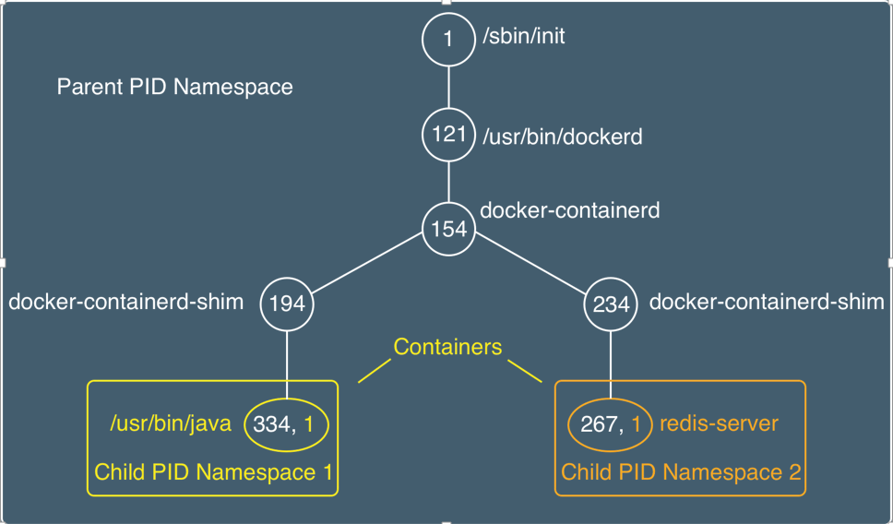
Example: PID Namespace

Slide 18
CGroup
Resource Allocation, Isolation
Enforce limits and constraints
  Memory cgroup - managing accounting, limits and notifications.
    CPU group - managing user / system CPU time and usage.
    BlkIO cgroup - measuring & limiting amount of blckIO by group.
    net_cls and net_prio cgroup - tagging the traffic control.
    Devices cgroup - reading / writing access devices.
    And much more…
Notes:
Key Points:
The resources used by a container is managed by Linux control groups. You can decide on how much CPU and memory resource a container should use using Linux control groups.

Slide 19
SELinux
Security Enhanced Linux (SELinux) is a mandatory access control system.
Processes, files, memory, network interfaces…, are labeled and there is a policy which is administratively set and fixed.
Controls
    Process initialization and inheritance and program execution
    File systems, directories, files, and open file descriptors
    Sockets, messages, and network interfaces
    Use of capabilities
Notes:
Key Points:
The Docker SELinux security policy is similar to the libvirt security policy and is based on the libvirt security policy. The libvirt security policy is a series of SELinuxpolicies that defines two ways of isolating virtual machines.

Slide 20
Docker Architecture
Docker uses a client-server architecture.
The Docker client talks to the Docker daemon, which does the heavy lifting of building, running, and distributing your Docker containers.
The Docker client and daemon can run on the same system, or you can connect a Docker client to a remote Docker daemon.
The Docker client and daemon communicate using a REST API, over UNIX sockets or a network interface.
Notes:
Key Points:
Docker Daemon or server is responsible for all the actions that are related to containers.
The daemon receives the commands from the Docker client through CLI or REST API’s. Docker client can be on the same host as a daemon or it can be present on any other host.

Slide 21
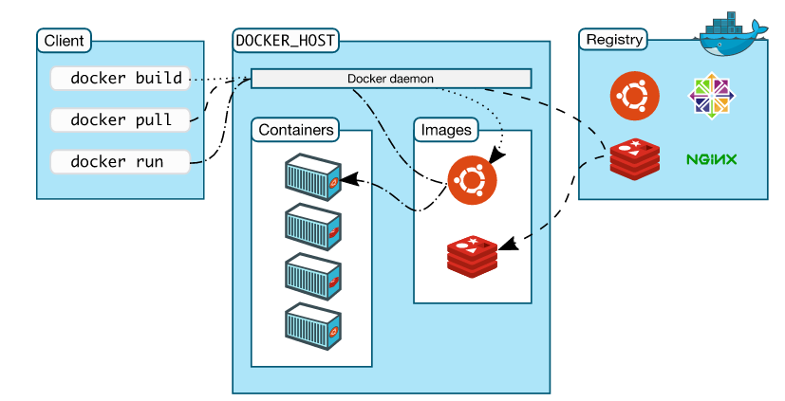
Docker Architecture
Notes:
Key Points:
And this time we’ll discuss the above picture from left to right:
First we have the client on the left, this is where we’re running various Docker commands. The client could be installed on your laptop running Windows, MacOS or a server running Linux, it doesn’t matter.
Next up, we have the Docker host. This is typically referred to as the server running the Docker daemon. That makes sense right? It’s the host that happens to be running the Docker daemon.
It’s very simple to configure the Docker client to connect to a remote Docker host. This is one way you’re able to run Docker on MacOS and Windows.
In that case, the Docker daemon ends up running in a virtual machine that uses Linux, and the Docker client is configured to connect to that remote Docker host.
The key take away here is, the client and daemon does not need to be on the same box.
Lastly, we have the registry which is also part of the Docker ecosystem but for now you can ignore it. Discussing what that does goes beyond the scope of this article, but it would have looked weird if I chopped it out because then the arrows would be coming from no where.
Just understand that it’s not something that’s installed by default with Docker, but instead, a place to find and download Docker images.

Slide 22
Docker Components
Docker Daemon
    Docker daemon is a background server side process that manages images and containers.
Docker Client
    The Docker client, in the form of the Docker binary, is the primary user interface to Docker..
Docker Images
    A Docker image is a read-only template.
    Docker provides a simple way to build new images or update existing images
    Download Docker images that other people have already created.
Notes:
Key Points:
The Docker daemon is a service that runs on your host operating system. It currently only runs on Linux because it depends on a number of Linux kernel features, but there are a few ways to run Docker on MacOS and Windows too.
The Docker client talks to the Docker server (or daemon) which, in turn, does all the work. Docker ships with a command line client binary (for Linux, OS X, and Windows) as well as a full RESTful API. You can run the Docker daemon and client on the same Linux host or connect your local Docker client to a remote daemon running on another Linux host.
The Docker Images are the basic building blocks of Docker. Containers are built from images. Images can be configured with applications and used as a template for creating containers. Images are organized in a layered manner. Every change in an image is added as a layer on top of it.

Slide 23
Docker Components (Cont.)
Docker Containers
  Docker containers are similar to a directory.
  A Docker container holds everything that is needed for an application to run.
  Each container is created from a Docker image.
  Docker containers can be run, started, stopped, moved, and deleted.
  Docker Hub
  Docker Hub is a registry of Docker images.
  Public Repository of Docker images.
Notes:
Key Points:
Container is the execution environment for Docker. Containers are created from images. It is a writable layer of the image. You can package your applications in a container, commit it and make it a golden image to build more containers from it.
Containers can be started, stopped, committed and terminated. If you terminate a container without committing it, all the changes made to the container will be lost.
Docker hosted registry service called Docker Hub. It allows you to upload and download images from a central location. If your repository is public, all your images can be accessed by other Docker hub users.
Docker hub acts like git, where you can build your images locally on your laptop, commit it and then can be pushed to the Docker hub.

Slide 24
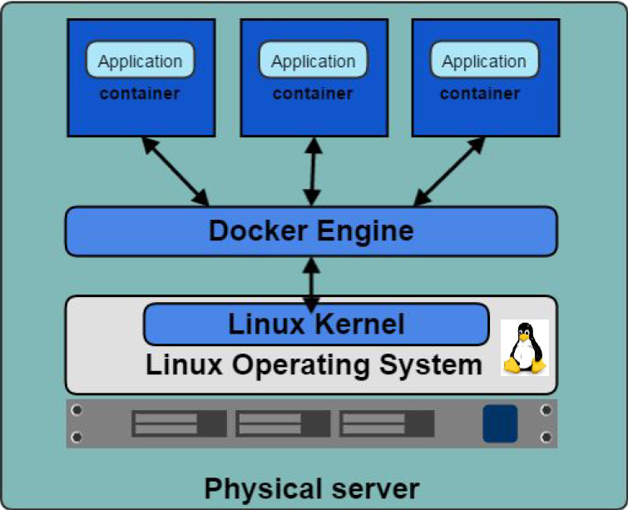
Docker Engine
Container execution and admin
Uses Linux Kernel namespaces and control groups
Namespaces provide for isolated workspace
Notes:
Key Points:
The Docker Engine is THE core piece of technology that allows you to run containers. In order for a container to run on any Linux host, at a minimum, the Docker Engine needs to be installed. Then the container can run on any Linux host where Docker Engine is installed, providing the benefit of portability, without doing any application specific configuration changes on each host.

Slide 25
Understanding How the Pieces Work
Your Virtual Box/Ubuntu
Docker Registry
(public or private)
Run docker.io daemon
Maintains local Cache
Gets and pushes images
You run copies of images from the local cache which become “containers” when they “run”
Container
CentOS
Containers
CentOS+GNUplot
Containers
CoreOS

Slide 26
So What Do I Get With Docker?
Docker server/daemon
Docker Images (and Docker File)
Registries
Containers
Command line tools for management
REST API for management (and automation)
Git philosophy and Docker images
Notes:
More about REST API in future class

Slide 27
Drawbacks of Docker
All Containers are run inside the host system's Kernel and not with a different Kernel
Windows and Linux Containers cannot be on the same host
Managing a large number of containers is challenging – especially when it comes to clustering containers.
    Tools like Google Kubernetes and Apache Mesos can help here.

Slide 28
Docker Installation

Slide 29
Hardware and Software Requirements
Software | Hardware
Linux: Any distribution running version 3.10+ of the Linux kernel Microsoft Windows: Windows Server 2016 Windows 10 Cloud: Amazon EC2 Google Compute Engine Microsoft Azure | The Docker platform runs natively on Linux (on x86-64, ARM and many other CPU architectures) and on Windows (x86-64). Minimum not stated clearly (it can run on IoT devices too) Minimum 512MB RAM, 1 Ghz CPU recommended.

Slide 30
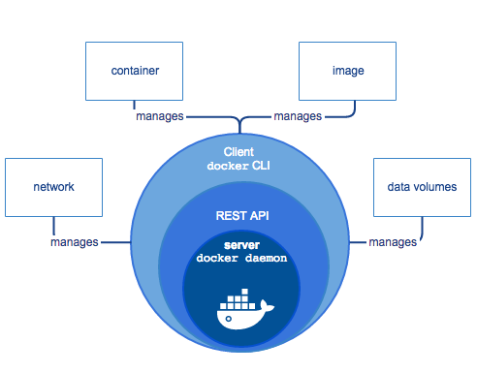
Install Docker

Slide 31
Install Docker
It can be installed via:
    Distribution-supplied packages on virtually all distros.
    Arch Linux, CentOS, Debian, Fedora, Gentoo, openSUSE, RHEL, Ubuntu.)
  Packages supplied by Docker
  Installation script from Docker
  Binary download from Docker (it's a single file)

Slide 32
Installing Docker on OS
  On CentOS 7
      yum install docker
  On Fedora
      yum install docker-io
  On Debian and Derivatives
      sudo apt-get install docker.io

Slide 33
Run Platforms
  Various Linux distributions (Ubuntu, Fedora, RHEL, Centos, openSUSE, ...)
  Cloud (Amazon EC2, Google Compute Engine, Rackspace)
  2014-10: Microsoft announces plans to integrate Docker with next release of Windows Server

Slide 34
Verify Installed Docker
  docker info
  Docker version
  docker search centos
  docker pull centos
  docker run ubuntu Hello World
  docker images [-a]
  docker ps –a

Slide 35
Uninstalling the Docker
  List the package you have installed
    yum list installed | grep docker
  Remove the package
    yum –y remove docker docker-engine.x86_64 1.18-1
  To delete all images, containers, and volumes, run the following command:
    rm -rf /var/lib/docker
  Locate and delete any user-created configuration files

Slide 36
Time-based Release Schedule
  Starting with Docker 18.03, Docker uses a time-based release schedule.
    Docker CE Edge releases generally happen monthly.
    Docker CE Stable releases generally happen quarterly, with patch releases as needed.
    Docker EE releases generally happen twice per year, with patch releases as needed.

Slide 37
Updates and Patches
  A given Docker EE release receives patches and updates for at least one year after it is released.
  A given Docker CE Stable release receives patches and updates for one month after the next Docker CE Stable release.
  A given Docker CE Edge release does not receive any patches or updates after a subsequent Docker CE Edge or Stable release.

Slide 38
Overview of Docker Images
  Docker Image can be compared to a template which is used to create Docker Containers.
  They are the building blocks of a Docker Container.
  These Docker Images are created using the build command.
  These Read only templates are used for creating containers by using the run command.

Slide 39
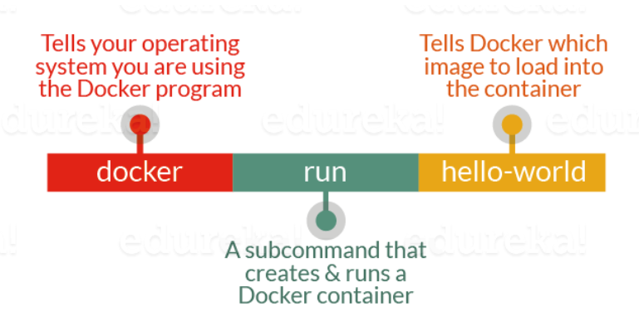

Slide 40
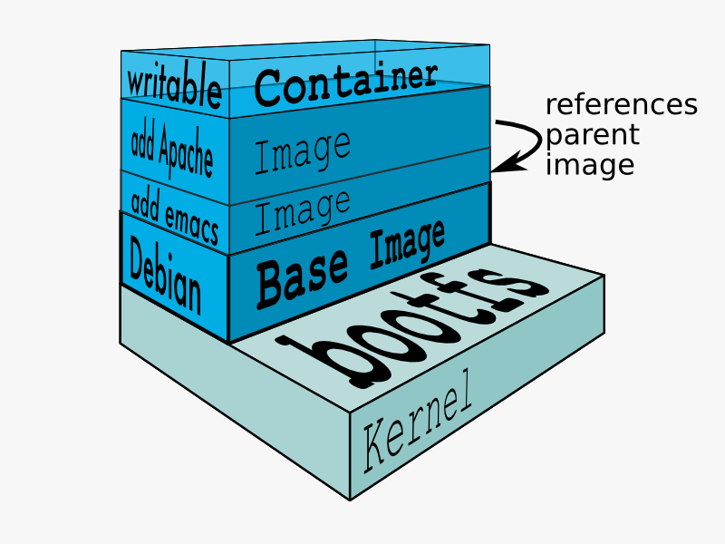
Docker Images
  An image is a collection of files + some meta data. (Technically: those files form the root filesystem of a container)
  Images are made of layers, conceptually stacked on top of each other
  Each layer can add, change, and remove files
  Images can share layers to optimize disk usage, transfer times, and memory use
Notes:
Key Points:
Docker Images are the basic building blocks of Docker. Containers are built from images. Images can be configured with applications and used as a template for creating containers. Images are organized in a layered manner. Every change in an image is added as a layer on top of it.

Slide 41
What are Images?
  A filesystem for container process
  Made of stack of immutable layers
  Start with a base image
  New layer for each changes
3. Add config files
Image = layered FS
2. Add Apache
1. Base OS: Debian

Slide 42
Sharing Layers
4. Add NPM
3. Add Configure files
3. Add Node
2. Add Apache
2. Add NGINX
Image_1
Image_2
1. Base OS : Debian

Slide 43
Writeable Container Layer
docker container run Image_2
docker container run Image_1
R/W Container Layer
R/W Container Layer
R/W Container Layer
4. Add NPM
3. Add Configure files
3. Add Node
2. Add Apache
2. Add NGINX
1. Base OS : Debian
Host Kernel

Slide 44
Terminology Docker Images
  docker cmd arg
    images: List all local images
    run: Create a container from an image and execute a command in it
    tag: Tag an image
    pull: Download image from repository
    rmi: Delete a local image

Slide 45
Creating Images
  Three Methods
    commit the R/W container layer as a new R/O image layer
    Define new layers to add to a starting image in a Dockerfile
    Import a Tarball into Docker as a standalone base layer.

Slide 46
Committing Docker Images
  Create a new image from a container's changes
  docker commit [OPTIONS] CONTAINER [REPOSITORY[:TAG]]
  Options
-a, --author string | Author (e.g., "John Hannibal Smith <hannibal@a-team.com>")
-c, --change value | Apply Dockerfile instruction to the created image (default [])
--help | Print usage
-m, --message string | Commit message
-p, --pause | Pause container during commit (default true)

Slide 47
Committing Container Changes
  docker container commit
  Saves container layer as a new R/O image layer
    Pro: Build images interactively
    Con: Hard to reproduce or audit

Slide 48
Authoring Images With run/commit
  docker start <containerid>
  docker run <imagename> bash
  docker commit <containerid> <imagename>
  docker tag <imagename> <user/image>
  docker push <user/image>
  docker pull <user/image>

Slide 49
Pros and Cons – Docker Images
  Pros
    Convenient, nothing to learn
    Can roll back/forward if needed
  Cons
    Manual process
    Iterative changes stack up
    Full rebuilds are boring, error-prone

Slide 50
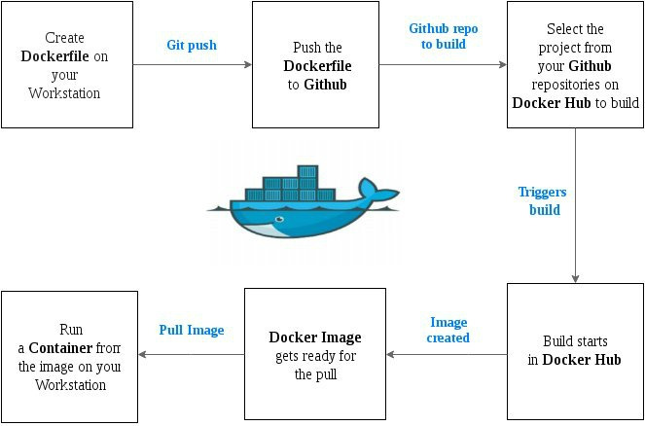
Docker Has a Repository Like GitHub
  push and pull container images to/from the Docker registry, which is something like a “GitHub” for Docker container images.

Slide 51
Docker Hub
Docker Hub is a cloud-based registry service which allows you to:
    Link to code repositories,
    Build your images and Test them
    Stores manually pushed images
Docker Hub is the default registry used when you docker push or docker pull.
Notes:
Key Points:
Docker Hub is a cloud registry service for sharing application and automating workflows.

Slide 52
Features
Image Repositories: Find, manage, push and pull images from community, official
Automated Builds: Automatically create new images when you make changes to a source code repository
Webhooks: A feature of Automated Builds, Webhooks let you trigger actions after a successful push to a repository
Organizations: Create work groups to manage access to image repositories

Slide 53
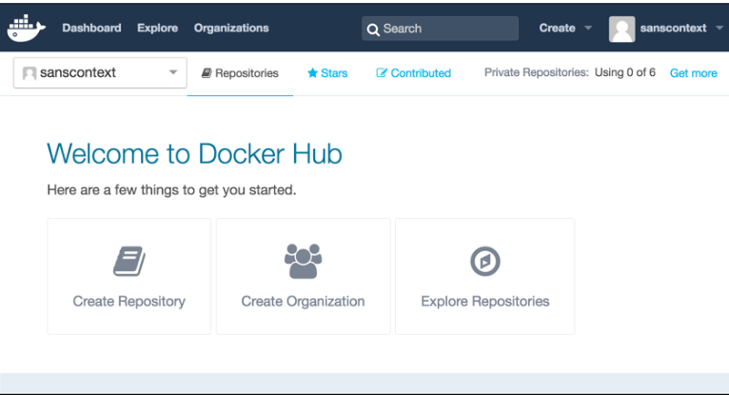
Docker Hub- Dashboard

Slide 54
Image vs Container
Base Image
ubuntu:latest
run
Container
cid1
base image
cmd → new state
New Image
iid1
commit
Container
cid1
run
Container
cid2
Container
cid3
Container
cid4

Slide 55
Image vs Container (Cont.)
  An image is a read-only filesystem
  A container is an encapsulated set of processes running in a read-write copy of that filesystem
  To optimize container boot time, copy-on-write is used instead of regular copy
  “docker run” starts a container from a given image

Slide 56
Basic Commands
Command | Description
ADD | Copies a file from the host system onto the container
CMD | The command that runs when the container starts
ENTRYPOINT | Allows to configure container that will run as a executable
ENV | Sets an environment variable in the new container
EXPOSE | Opens a port for linked containers
FROM | The base image to use in the build. This is mandatory and must be the first command in the file.
MAINTAINER | An optional value for the maintainer of the script
ONBUILD | A command that is triggered when the image in the Dockerfile is used as a base for another image
RUN | Executes a command and save the result as a new layer
USER | Sets the default user within the container
VOLUME | Creates a shared volume that can be shared among containers or by the host machine
WORKDIR | Set the default working directory for the container

Slide 57
What is Docker Registry?
  A Docker Registry is a place to store and distribute Docker images.
  It serves as a target for your docker push & docker pull commands.
  (OR)
  The Registry is a stateless, highly scalable server side application that stores and lets you distribute Docker images.
Notes:
Key Points:
Docker registry is a repository for Docker images. Using Docker registry, you can build and share images with your team. A regis try can be public or private.

Slide 58
Docker Registry
  A Docker Registry stores the layers and the description of how they make up an image
  Implements a common API agreed upon by Docker clients
  Several Implementations
    A simple web server to make images available
    A complete web application
    Service – Docker Hub and Docker Trusted Registry
Notes:
Key Points:
Docker registry is a repository for Docker images. Using Docker registry, you can build and share images with your team. A regis try can be public or private.

Slide 59
Why Use It?
You should use the Registry if you want to:
  Tightly control where your images are being stored
  Fully own your images distribution pipeline
  Integrate image storage and distribution tightly into your in-house development workflow

Slide 60
Terminology - Docker Registries
  Image
    An image is essentially a template for Docker containers. It consists of a manifest and an associated series of layers.
  Layer
    A layer represents a filesystem difference.
    An image’s layers are combined together into a single image that forms the base for a container’s filesystem.

Slide 61
Terminology - Docker Registries (Cont.)
Registry
  A registry is a content delivery and storage system for named Docker images.
Repository
  A repository is simply a collection of different versions for a single Docker image.
  Similar to a git repository.

Slide 62
Terminology - Docker Registries (Cont.)
Tag
    A tag is just a named version of the image.
    It allows you to identify a specific image later on.
    You can tag an image (almost) however you want.
    Best is to give it a meaningful, human-readable name.

